Slide 2

Ypp 4
bbv Software Services AG | Date: 21/07/2025

Slide 3




Presentation on MS Lists Functionalities
bbv Software Services AG | Date: 21/07/2025

Slide 4
Agenda
Introduction
Key Functionalities
Q&A

Slide 5

Introduction
What is MS Lists?

Slide 6
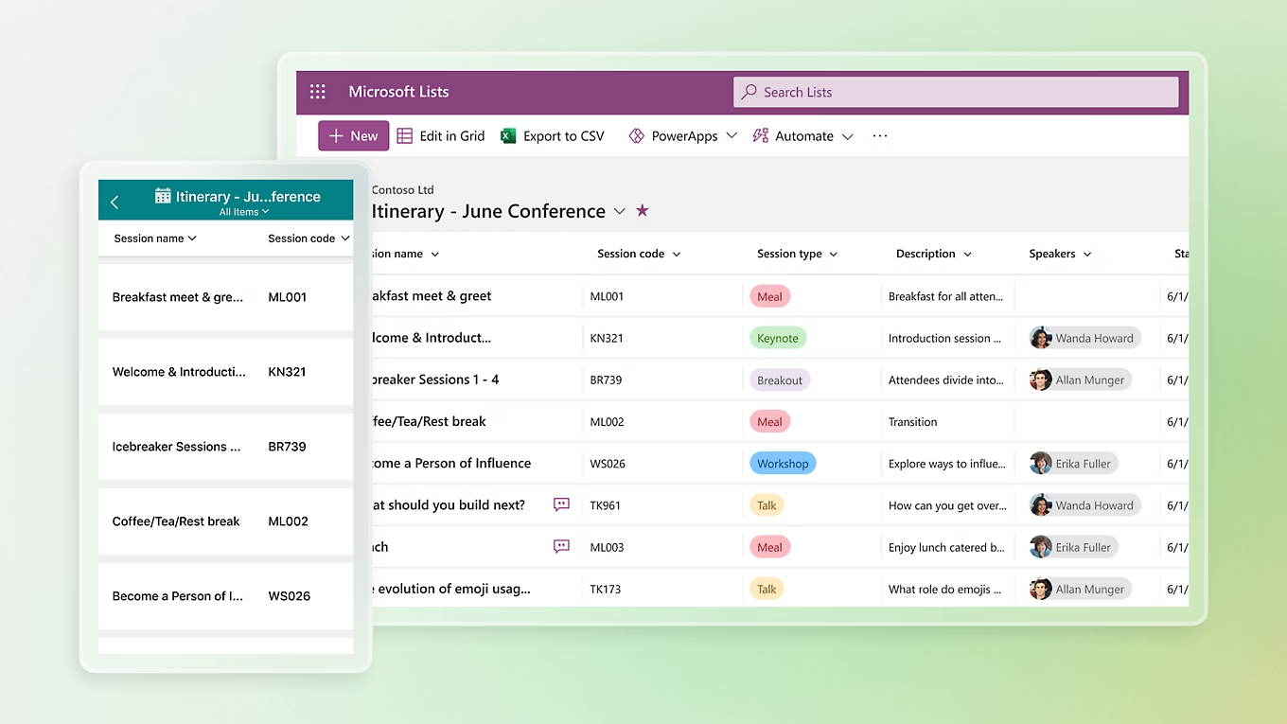
Introduction
What is Microsoft Lists
MS List is a tool for managing structured lists of data
Works like a simple table or database
Let’s users:
Create lists
View data
Manage info clearly and easily

Slide 7

Key Functionalitie

Slide 8
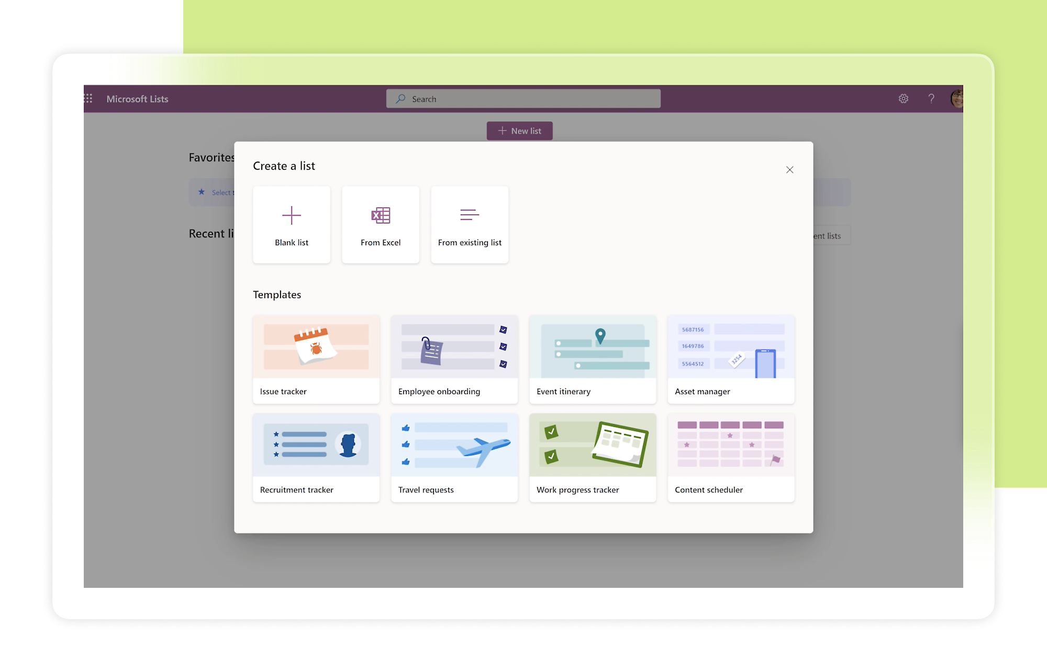
Key Functionalities of MS Lists
Create and Manage Lists
Custom Columns
Manage List Items
Custom Views
Conditional Formatting
Permissions and Sharing
Built-in Templates

Slide 9
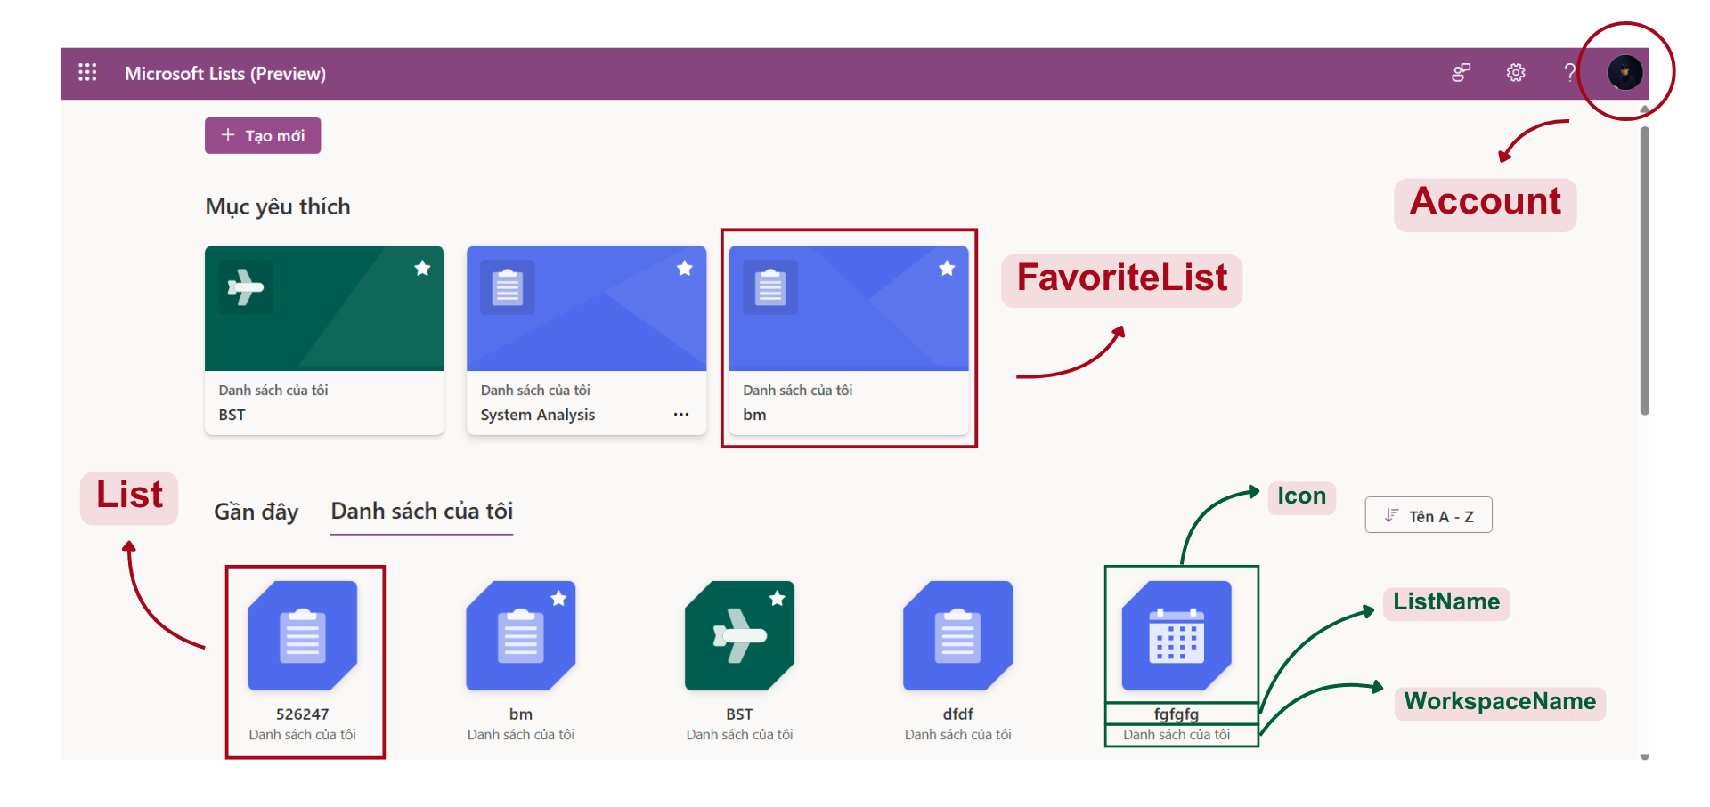
Dashboard Screen
Notes:
-- screen 1: dashboard & account
-- case 1: favorites list from user
SELECT l.Icon, l.Color, w.WorkspaceName, l.ListName
FROM List l
JOIN FavoriteList fl ON fl.Id = l.Id
JOIN Account a ON a.Id = fl.ListId
JOIN Workspace w ON w.Id = l.WorkspaceId
WHERE a.Id = 2
-- case 2: find recents list from user
SELECT l.ListName, l.Icon, w.WorkspaceName, l.CreateAt
FROM List l
JOIN Account a ON a.Id = l.CreatedBy
JOIN Workspace w ON w.Id = l.WorkspaceId
WHERE a.Id = 2
-- case 3: find all list from user
SELECT l.ListName, l.Icon, w.WorkspaceName
FROM List l
JOIN Account a ON a.Id = l.CreatedBy
JOIN Workspace w ON w.Id = l.WorkspaceId
WHERE a.Id = 2

Slide 10
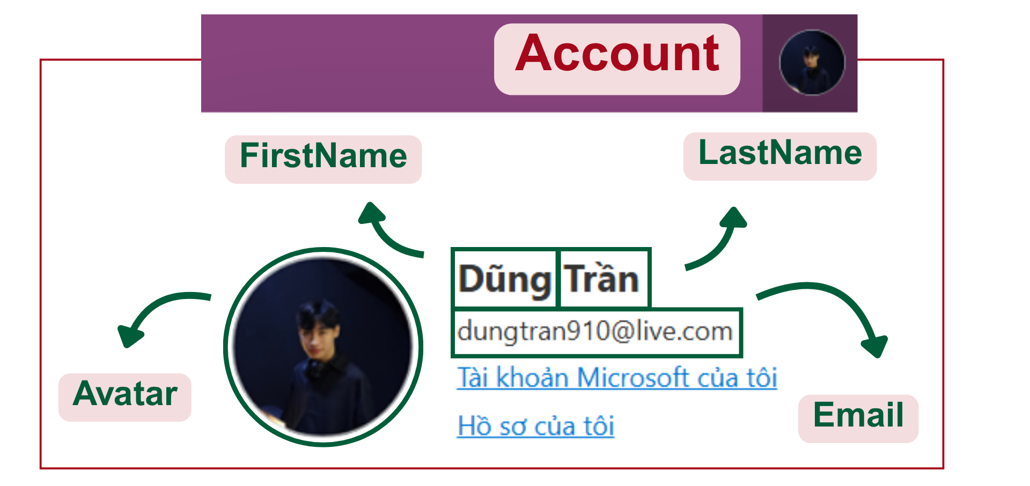
Dashboard Screen
Notes:
-- case 4: find Account by Id
SELECT a.FirstName, a.LastName, a.Email, a.Avatar, a.Company
FROM Account a WHERE a.Id = 1

Slide 11
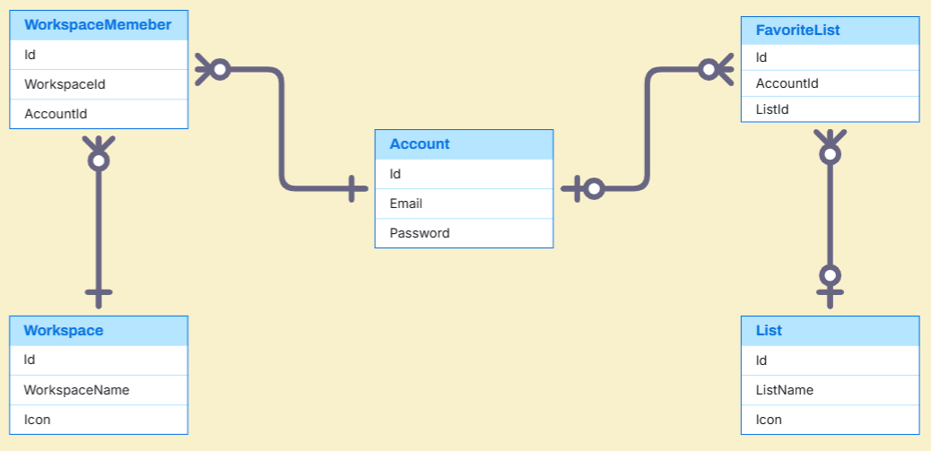
Dashboard Entities

Slide 12
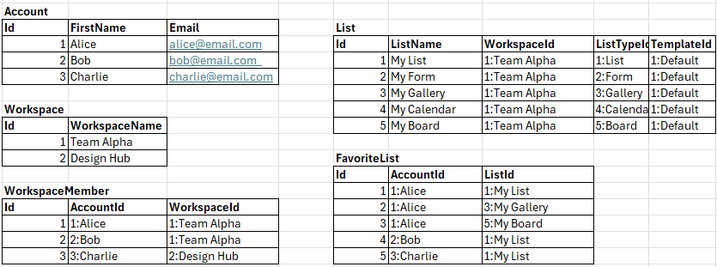
Dashboard Sample Data

Slide 13
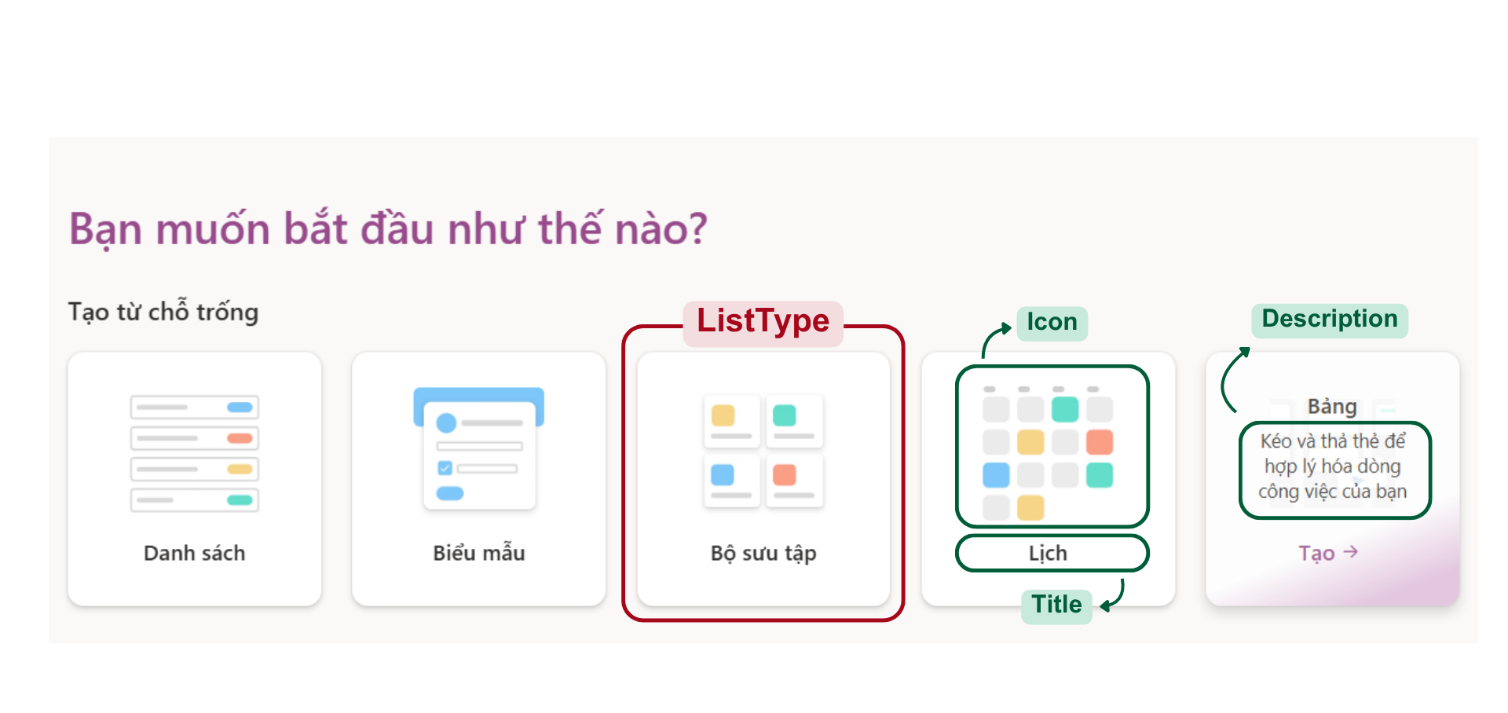
Create List Screen
Notes:
-- screen 2: create list screen (when user choose create new)
-- case 1: show list type
SELECT lt.Icon, lt.Title, lt.ListTypeDescription
FROM ListType lt

Slide 14
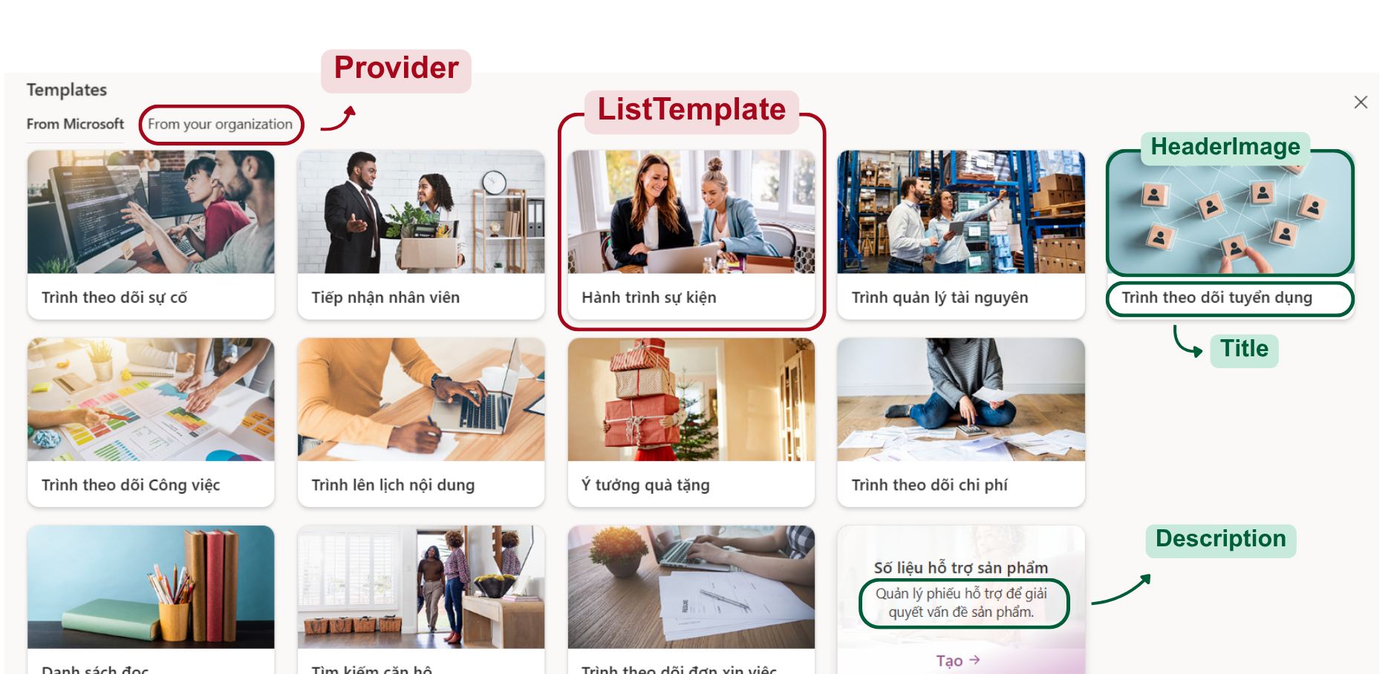
Create List Screen
Notes:
-- case 2: show template from Microsoft
SELECT lt.HeaderImage, lt.Title, lt.TemplateDescription
FROM ListTemplate lt
JOIN TemplateProvider tp ON tp.Id = lt.TemplateProviderId
WHERE tp.ProviderName = 'Microsoft'
-- case 3: show template from your organization
SELECT lt.HeaderImage, lt.Title, lt.TemplateDescription
FROM ListTemplate lt
JOIN TemplateProvider tp ON tp.Id = lt.TemplateProviderId
WHERE tp.ProviderName = 'Company'

Slide 15
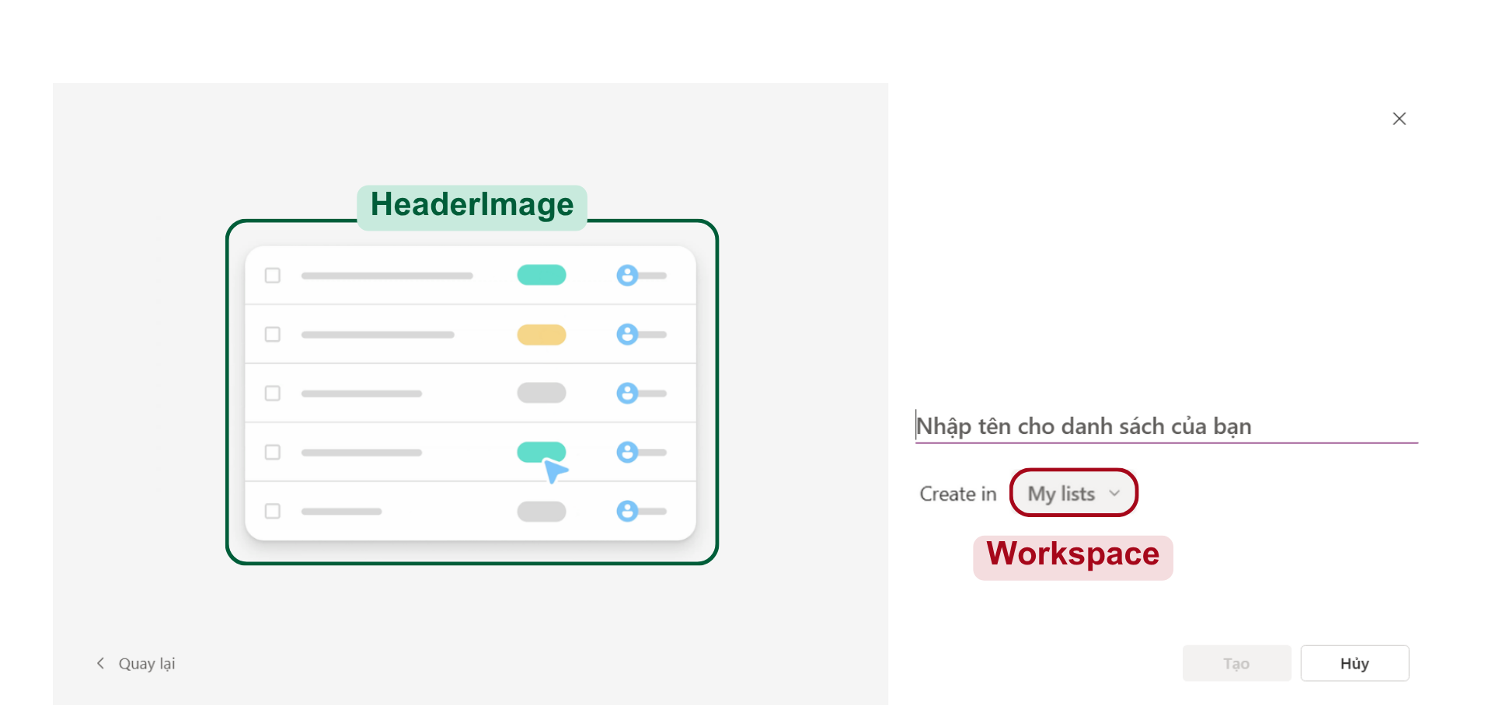
Create List From List Type
Notes:
-- screen 3: create list screen (when user choose List type)
-- case 1: show info List type
SELECT Title, ListTypeDescription, HeaderImage
FROM ListType
WHERE Title = 'List'
-- case 2: show all workspace by account id
SELECT w.WorkspaceName, w.Icon
FROM Workspace w
JOIN WorkspaceMember wb ON wb.WorkspaceId = w.Id
JOIN Account a ON a.Id = wb.AccountId
WHERE a.Id = 1

Slide 16
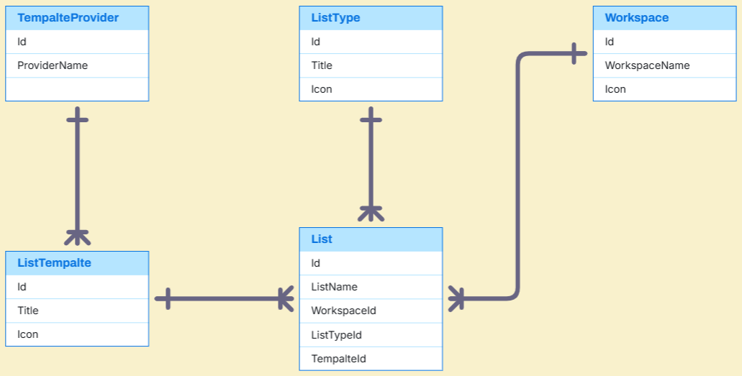
Create List Sample Data

Slide 17
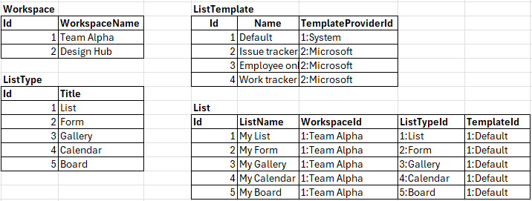
Create List Sample Data

Slide 18
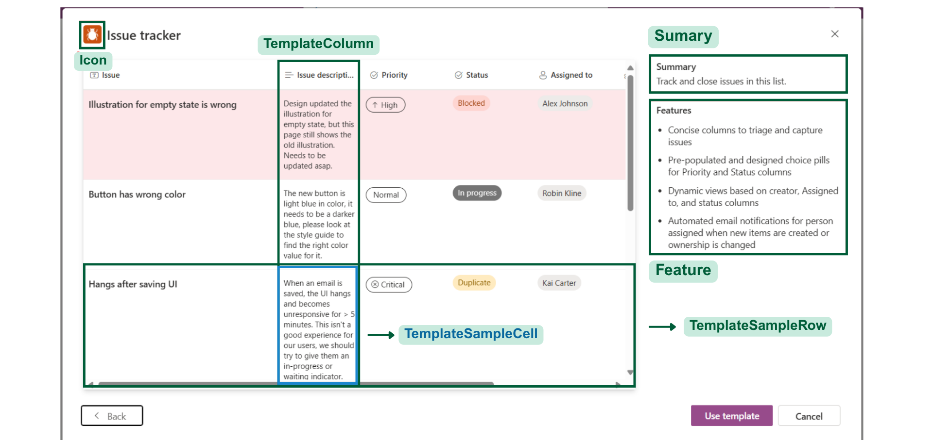
Create List From Template
Notes:
-- screen 4: when user choose template
-- case 1: find list template by id
SELECT lt.Id,
lt.Icon, lt.Title,
lt.Sumary, lt.Feature
FROM ListTemplate lt
WHERE lt.Id = 478
-- case 2: find sample data for list template
SELECT tsr.Id, tsr.DisplayOrder, tc.ColumnName, tsc.CellValue
FROM ListTemplate lt
JOIN TemplateColumn tc ON tc.ListTemplateId = lt.Id
JOIN TemplateSampleRow tsr ON tsr.ListTemplateId = lt.Id
LEFT JOIN TemplateSampleCell tsc
ON tsc.TemplateSampleRowId = tsr.Id
AND tsc.TemplateColumnId = tc.Id
WHERE lt.Id = 478

Slide 19
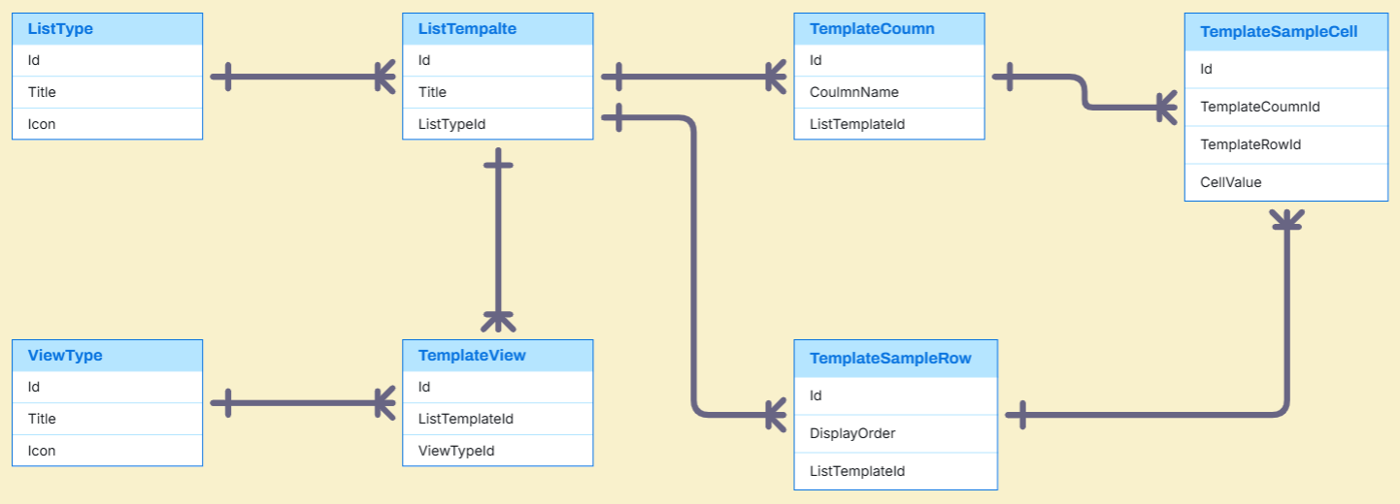
Template Entities

Slide 20
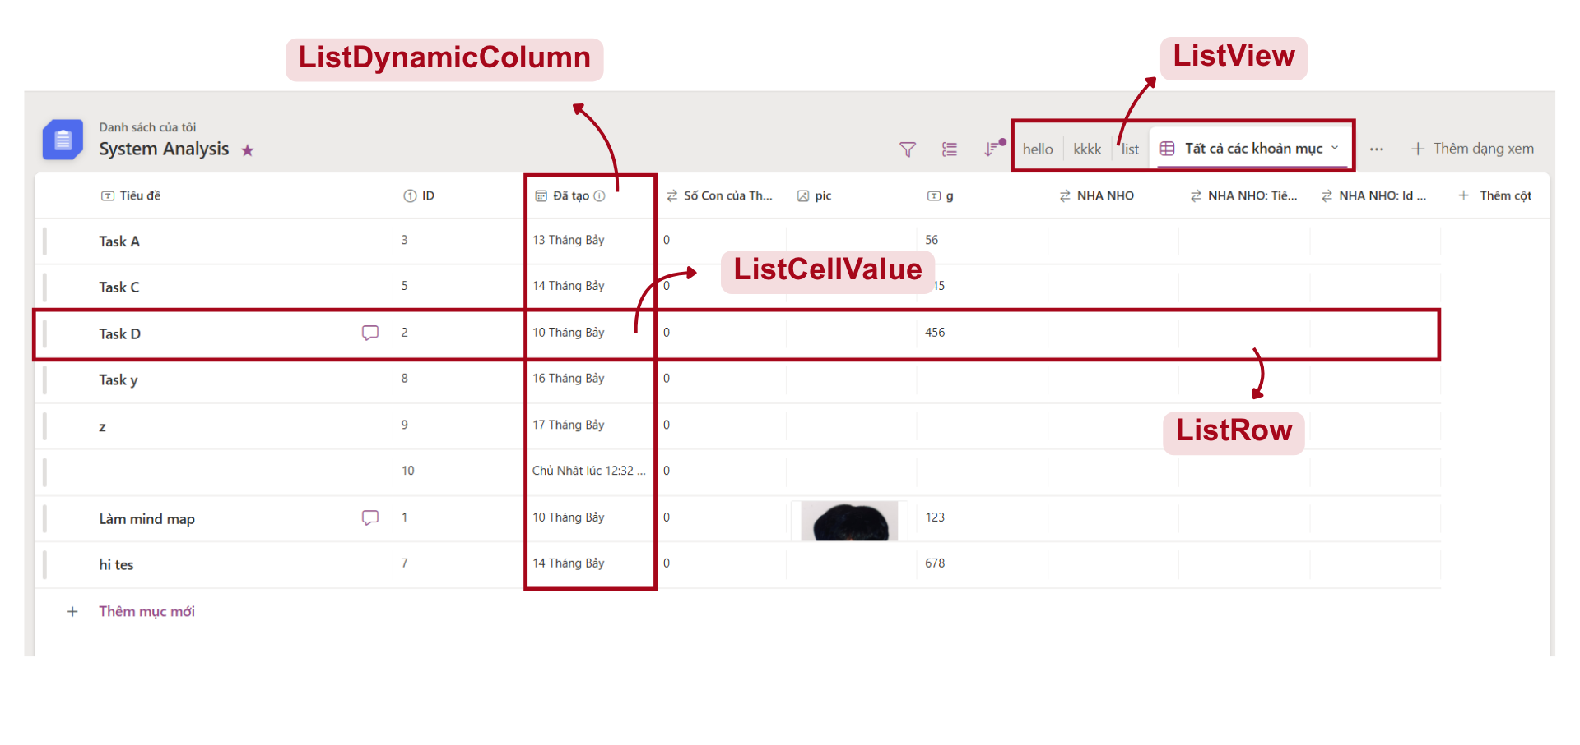
List Management
Notes:
-- screen 5: list (after user create list)
-- case 1: show info list
SELECT l.Icon, l.Color, w.WorkspaceName, l.ListName,
CASE
WHEN fl.Id IS NOT NULL THEN 1
ELSE 0
END AS IsFavoriteList
FROM List l
JOIN Workspace w ON w.Id = l.WorkspaceId
LEFT JOIN FavoriteList fl ON fl.ListId = l.Id AND fl.AccountId = 83
WHERE l.Id = 1
-- case 2: show list column is visible
SELECT sdt.Icon, ldc.ColumnName, sdt.DataTypeValue
FROM ListDynamicColumn ldc
JOIN List l ON l.Id = ldc.ListId
JOIN SystemDataType sdt ON sdt.Id = ldc.SystemDataTypeId
WHERE l.Id = 33 AND ldc.IsVisible = 1
-- case 3: show list data
SELECT lr.Id,
ldc.ColumnName, lr.DisplayOrder, lcv.CellValue
FROM List l
JOIN ListDynamicColumn ldc ON ldc.ListId = l.Id
JOIN ListRow lr ON lr.ListId = l.Id
LEFT JOIN ListCellValue lcv
ON lcv.ListRowId = lr.Id
AND lcv.ListDynamicColumnId = ldc.Id
WHERE l.Id = 33
ORDER BY lr.DisplayOrder
-- case 4: show list view
SELECT lv.ViewName
FROM ListView lv
JOIN List l ON l.Id = lv.ListId
WHERE l.Id = 3

Slide 21
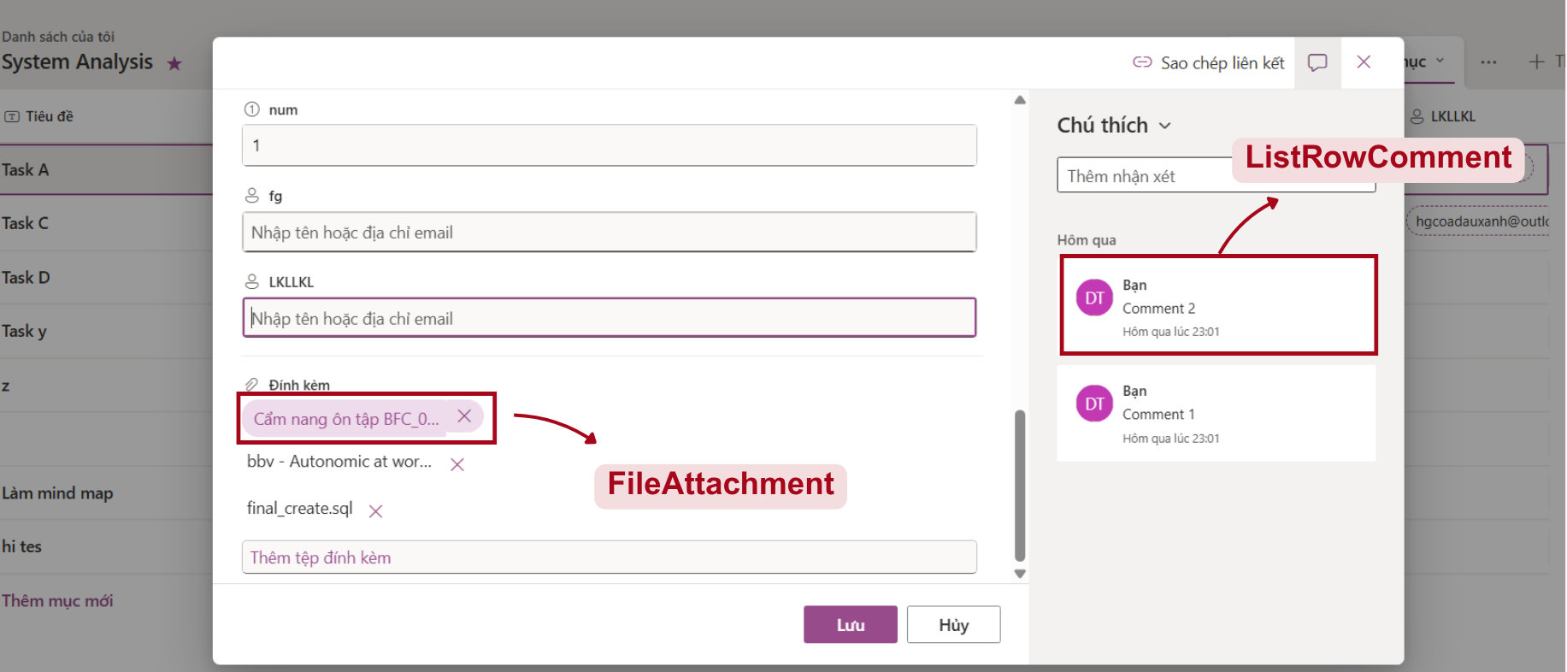
List Row Detail
Notes:
-- screen 7: List row detail
-- case 1: show row detail
SELECT lr.Id,
sdt.Icon, ldc.ColumnName, lcv.CellValue
FROM List l
JOIN ListDynamicColumn ldc ON ldc.ListId = l.Id
JOIN ListRow lr ON lr.ListId = l.Id
LEFT JOIN ListCellValue lcv
ON lcv.ListRowId = lr.Id
AND lcv.ListDynamicColumnId = ldc.Id
JOIN SystemDataType sdt ON sdt.Id = ldc.SystemDataTypeId
WHERE lr.Id = 702
-- case 2: show row file attachment
SELECT fa.NameFile, fa.FileUrl
FROM ListRow lr
JOIN FileAttachment fa ON fa.ListRowId = lr.Id
WHERE lr.Id = 702
-- case 3: show all comments by row
SELECT a.FirstName, a.LastName, a.Avatar, lrc.Content, lrc.CreateAt
FROM ListRowComment lrc
JOIN ListRow lr ON lr.Id = lrc.ListRowId
JOIN Account a ON a.Id = lrc.CreatedBy
WHERE lr.Id = 998
ORDER BY lrc.CreateAt DESC

Slide 22
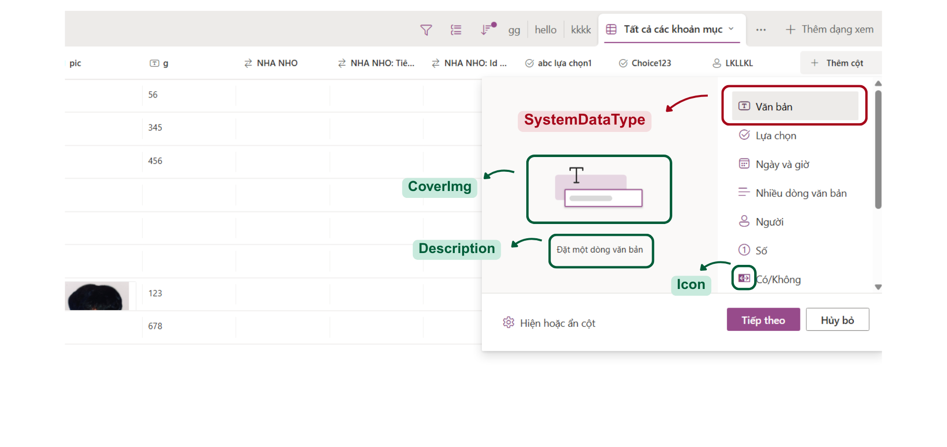
List Column
Notes:
-- screen 8: Custom column
-- case 1: find all column type
SELECT sdt.Icon, sdt.DisplayName, sdt.CoverImage, sdt.TypeDescription
FROM SystemDataType sdt
-- case 2: when user choose column type
SELECT sdt.DisplayName, sdt.DataTypeValue, ks.KeyName, ks.DisplayName, ks.ValueType
FROM DataTypeSettingKey dtsk
JOIN SystemDataType sdt ON sdt.Id = dtsk.SystemDataTypeId
JOIN KeySetting ks ON ks.Id = dtsk.KeySettingId
WHERE sdt.Id = 1
-- case 3: when user choose edit column
SELECT ldc.ColumnName, ldc.ColumnDescription,
sdt.DisplayName, sdt.DataTypeValue,
ks.KeyName, ks.ValueType, ks.DisplayName
FROM ListDynamicColumn ldc
JOIN SystemDataType sdt ON sdt.Id = ldc.SystemDataTypeId
JOIN DataTypeSettingKey dtsk ON dtsk.SystemDataTypeId = sdt.Id
LEFT JOIN ListColumnSettingValue lcsv
ON lcsv.ColumnId = ldc.Id AND lcsv.DataTypeSettingKeyId = dtsk.Id
JOIN KeySetting ks ON ks.Id = dtsk.KeySettingId
WHERE ldc.Id = 2

Slide 23
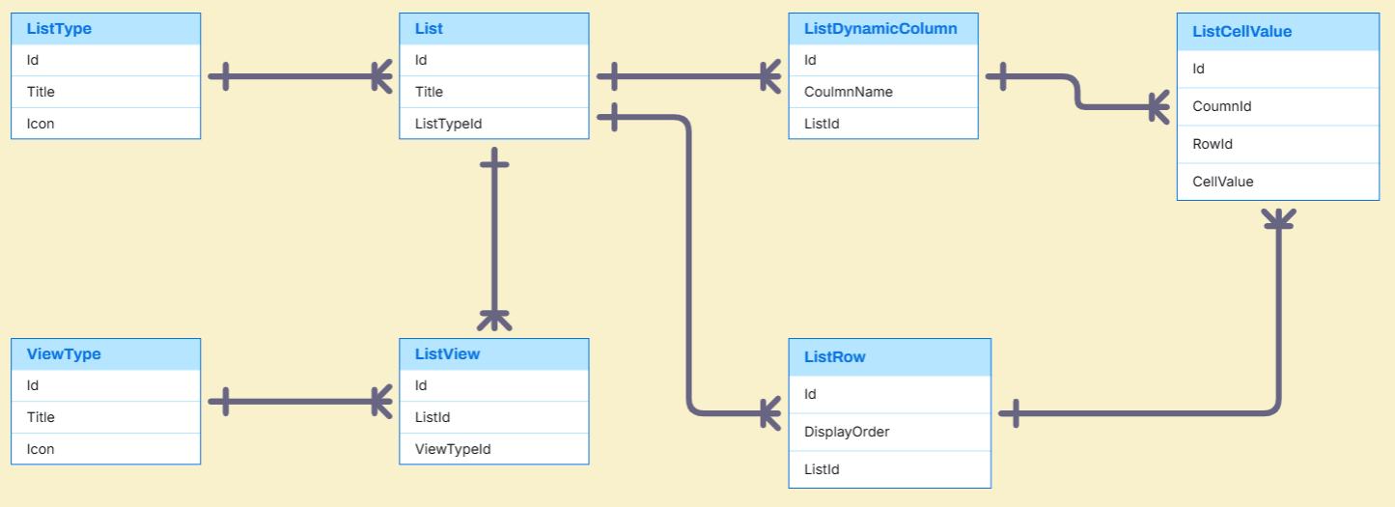
List Entities

Slide 24
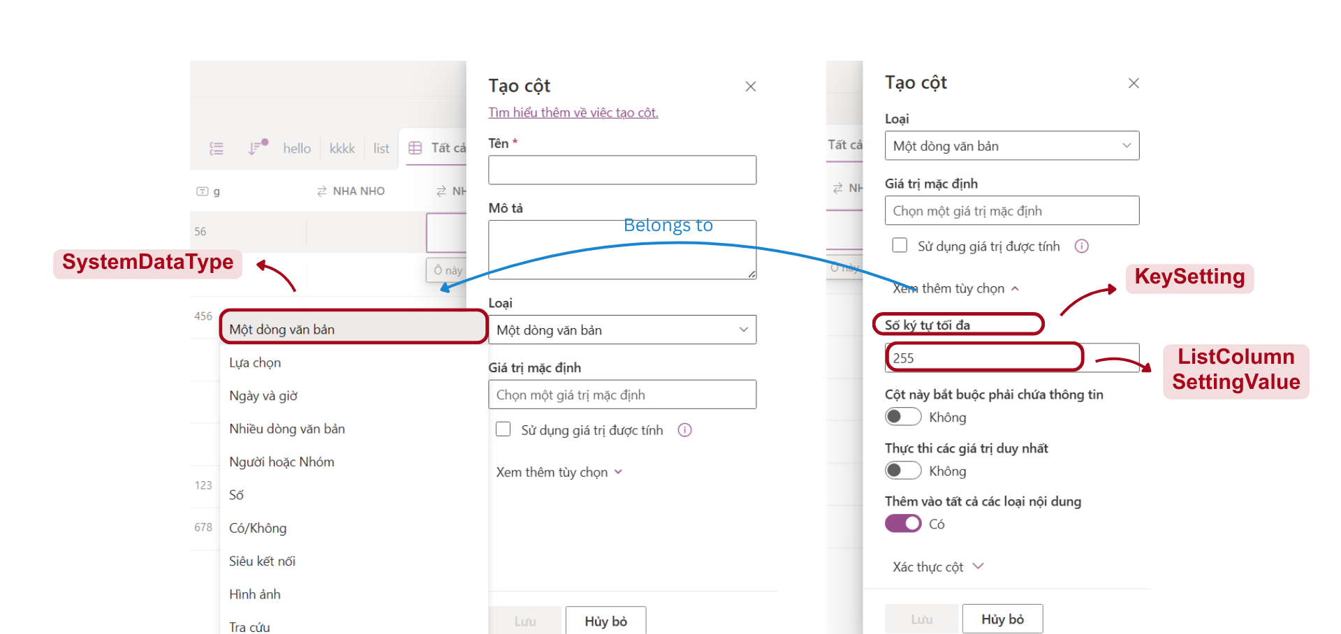
List Column Setting
Notes:
-- case 2: when user choose column type
SELECT sdt.DisplayName, sdt.DataTypeValue, ks.KeyName, ks.DisplayName, ks.ValueType
FROM DataTypeSettingKey dtsk
JOIN SystemDataType sdt ON sdt.Id = dtsk.SystemDataTypeId
JOIN KeySetting ks ON ks.Id = dtsk.KeySettingId
WHERE sdt.Id = 1

Slide 25
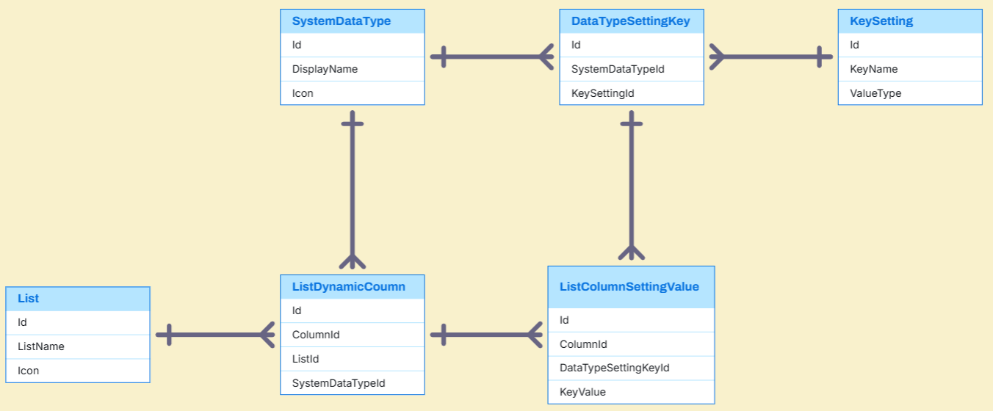
List Column Setting Entities

Slide 26
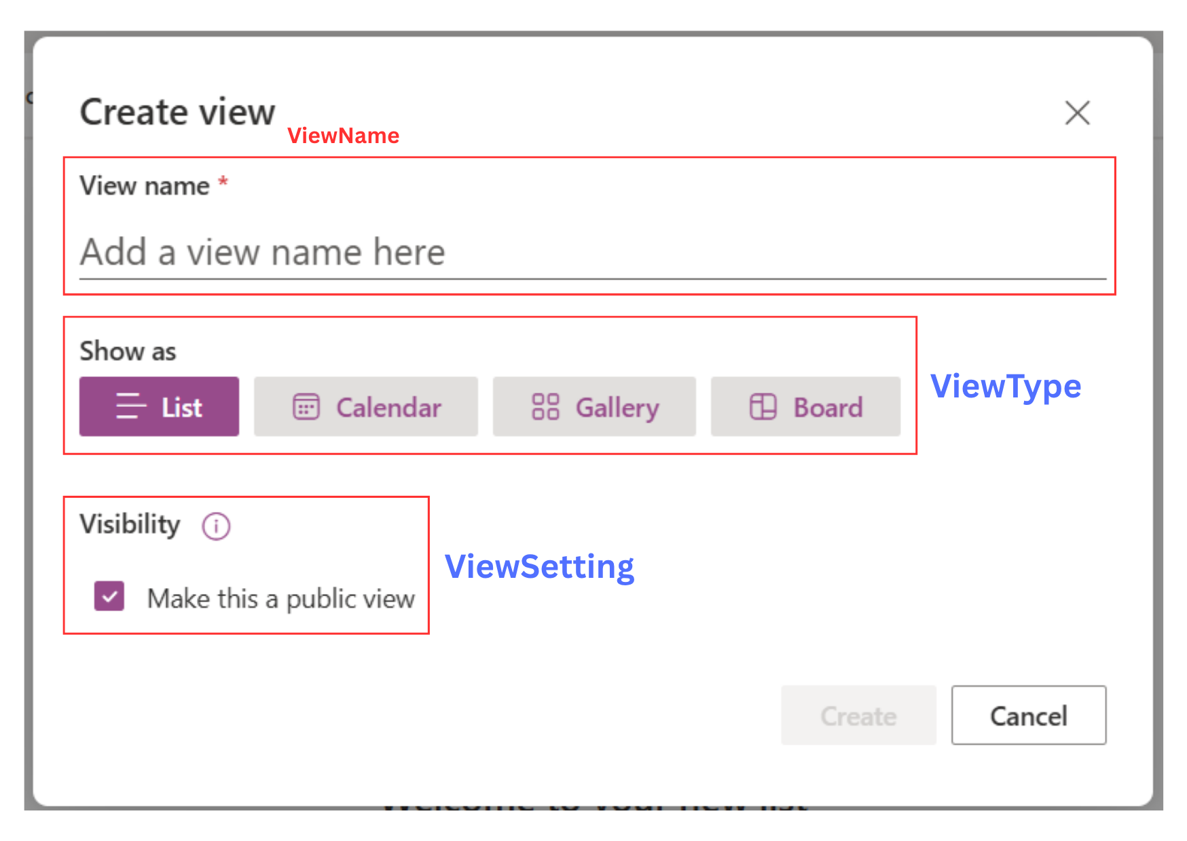
List View
Notes:
-- screen 9: create view for list
-- case 1: create view with calendar type
SELECT vt.Icon ,vt.TypeName, vs.DisplayName, vs.ValueType
FROM ViewTypeSetting vts
JOIN ViewType vt ON vt.Id = vts.ViewTypeId
JOIN ViewSetting vs ON vs.Id = vts.ViewSettingId
WHERE vt.TypeName = 'Calendar'
-- case 2: ref column have type DATE for Calendar View
SELECT ldc.ColumnName
FROM ListDynamicColumn ldc
JOIN SystemDataType sdt ON sdt.Id = ldc.SystemDataTypeId
JOIN List l ON l.Id = ldc.ListId
WHERE sdt.DataTypeValue = 'DATE' AND l.Id = 299
-- case 3: ref title & subheading column for Calendar View
SELECT ldc.ColumnName
FROM ListDynamicColumn ldc
JOIN SystemDataType sdt ON sdt.Id = ldc.SystemDataTypeId
JOIN List l ON l.Id = ldc.ListId
WHERE l.Id = 2

Slide 27
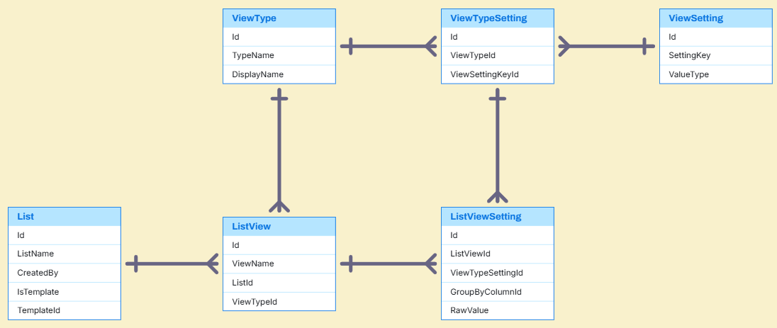
List View Entities

Slide 28
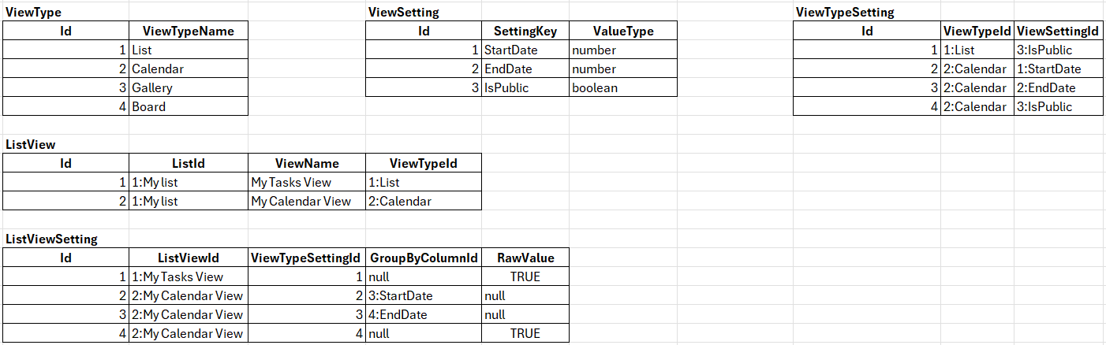
List View Sample Data

Slide 29
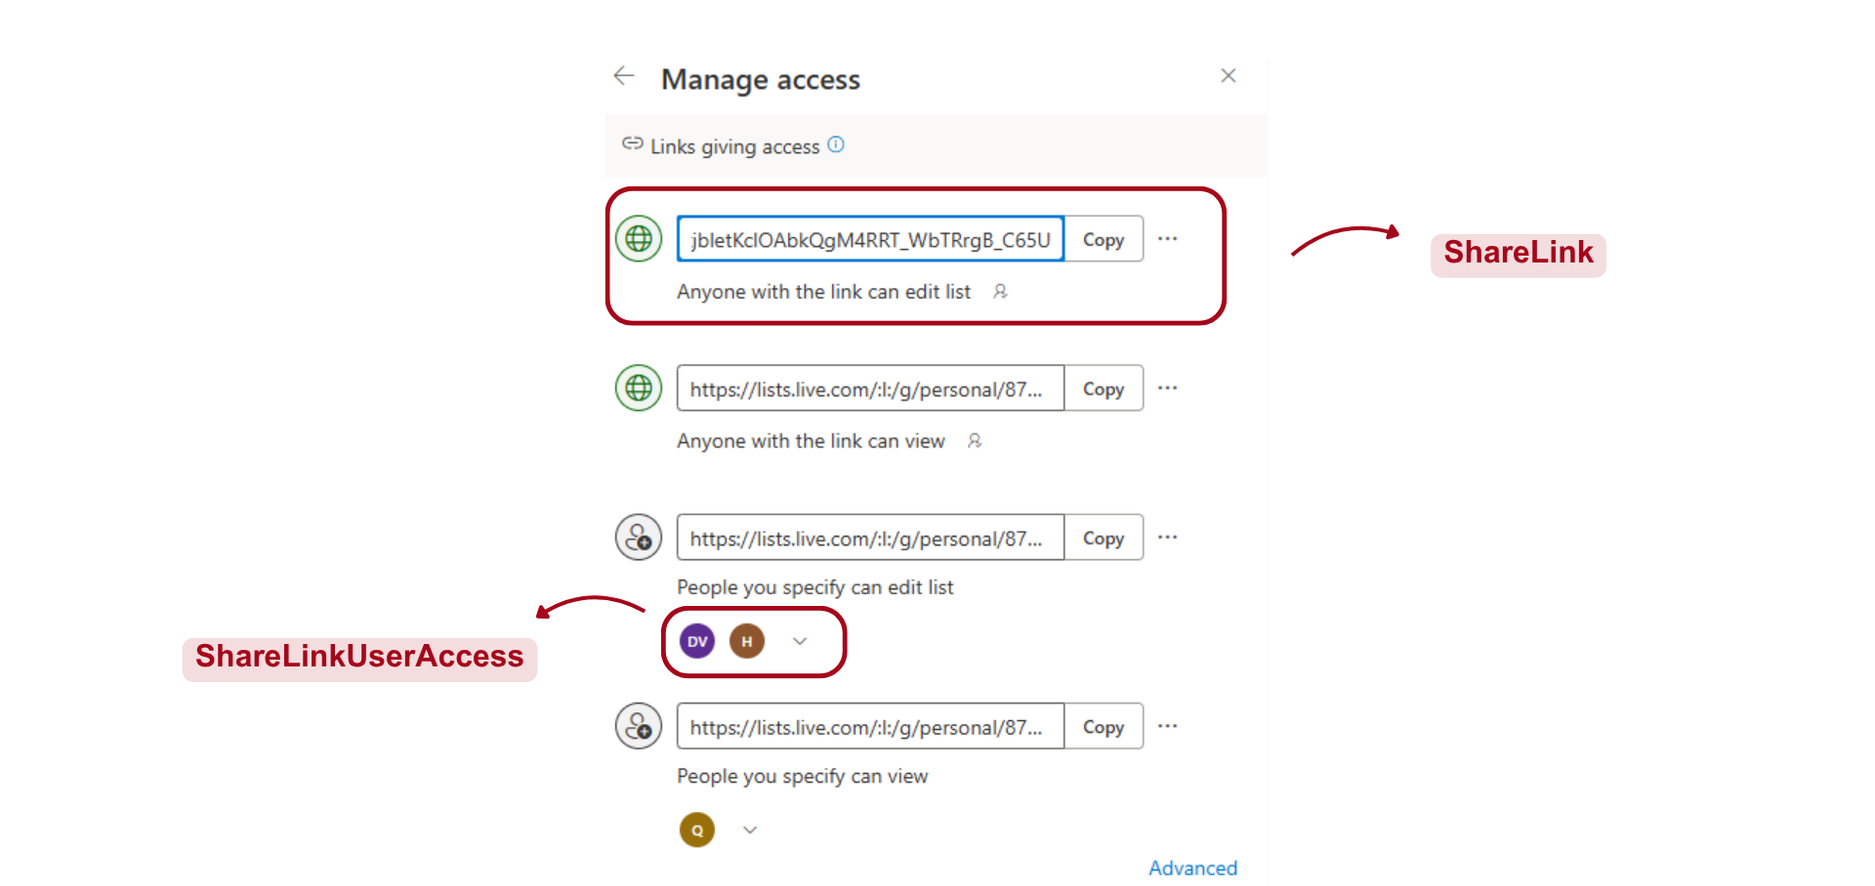
Manage Access
Notes:
-- screen 10: share link
-- case 1: show curent list name
SELECT ListName
FROM List
WHERE Id = 14
-- case 2: show all scope
SELECT ScopeIcon, ScopeName, ScopeDescription, ScopeCode
FROM Scope
-- case 3: show all permission
SELECT PermissionIcon, PermissionName, PermissionDescription, PermissionCode
FROM Permission
-- case 4: show option if user choose scope 'PUBLIC'
SELECT s.ScopeIcon, s.ScopeName, s.ScopeDescription
FROM ShareLinkOption slo
JOIN Scope s ON s.Id = slo.ScopeId
WHERE s.ScopeCode = 'PUBLIC'
-- case 5: show option if user choose scope 'SPECIFIC'
SELECT s.ScopeIcon, s.ScopeName, s.ScopeDescription
FROM ShareLinkOption slo
JOIN Scope s ON s.Id = slo.ScopeId
WHERE s.ScopeCode = 'SPECIFIC'

Slide 30
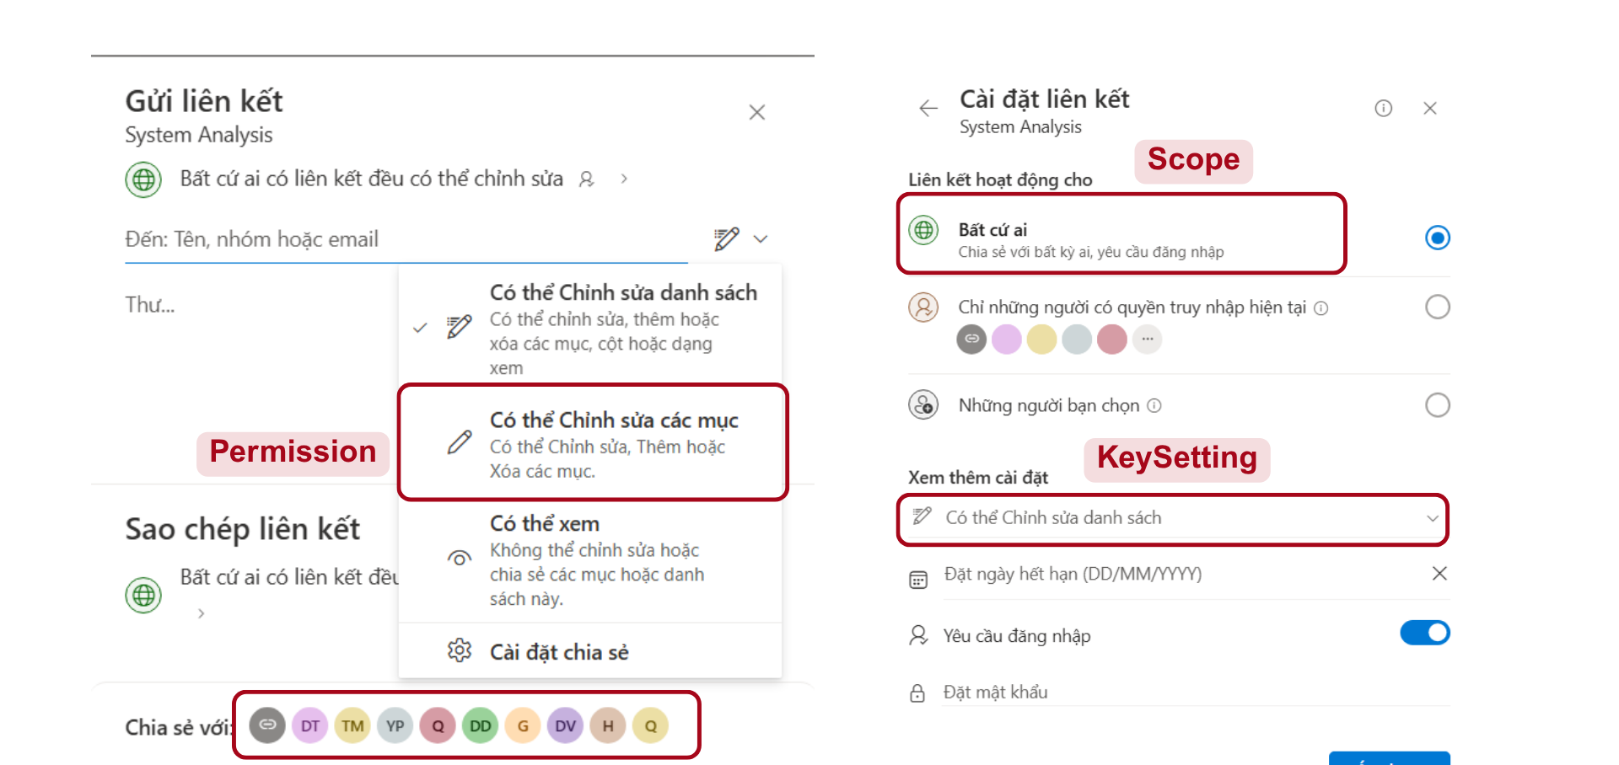
Manage Access
Notes:
-- screen 11: manage access
-- case 1: count people have permission
SELECT COUNT(*) AS People
FROM ListMemberPermission lmp
JOIN List l ON l.Id = lmp.ListId
JOIN Permission p ON p.Id = lmp.HighestPermissionId
JOIN Account a ON a.Id = lmp.AccountId
WHERE l.Id = 14
-- case 2: show info all user have permission in list
SELECT l.ListName, a.Avatar, a.FirstName, a.LastName,
a.Email, p.PermissionIcon, p.PermissionName
FROM ListMemberPermission lmp
JOIN List l ON l.Id = lmp.ListId
JOIN Permission p ON p.Id = lmp.HighestPermissionId
JOIN Account a ON a.Id = lmp.AccountId
WHERE l.Id = 14

Slide 31
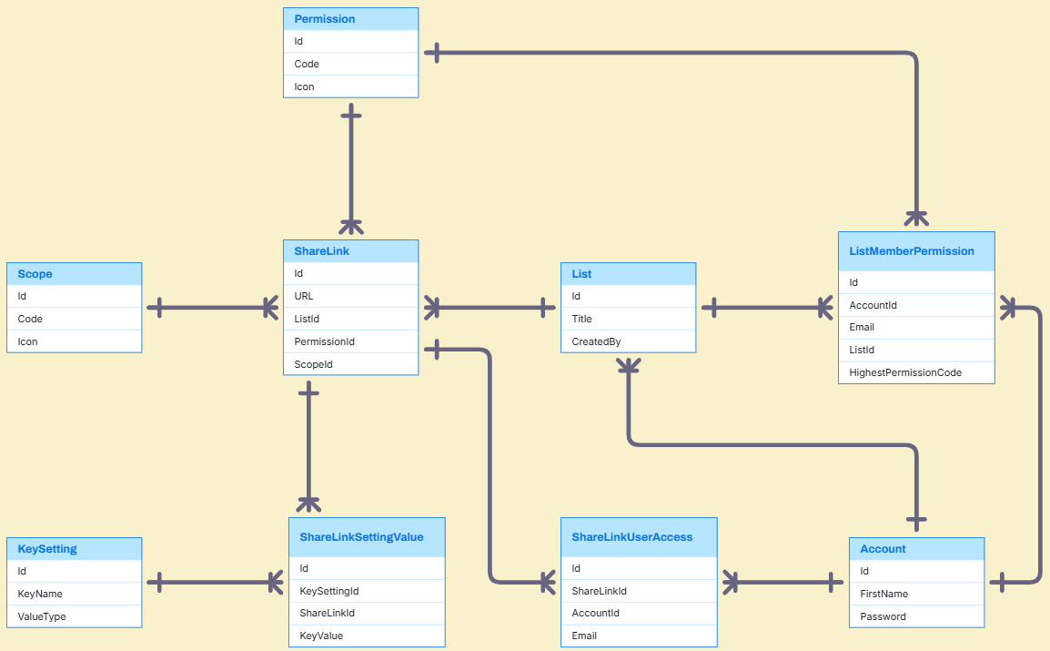
Manage Access Entities

Slide 32
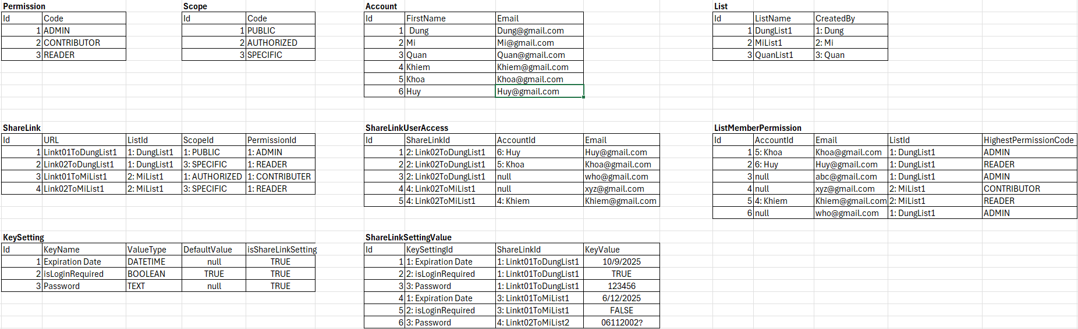
Manage Access Sample Data

Slide 33
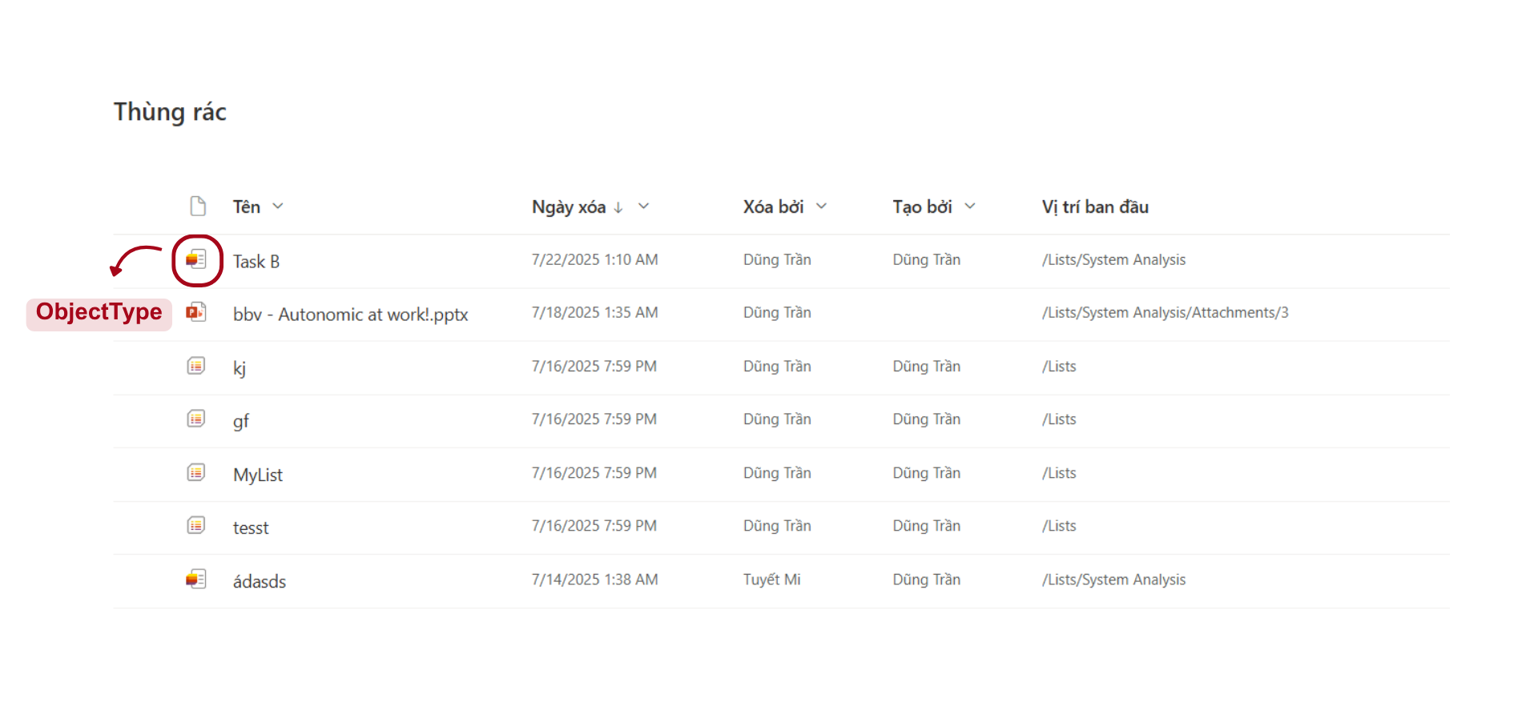
Trash
Notes:
-- screen 12: trash items
-- case 1: default
SELECT TOP 20
ot.ObjectName,
FORMAT(ti.DeleteAt, 'M/d/yyyy h:mm tt') AS DateDeleted,
deleter.FirstName + ' ' + deleter.LastName AS DeletedBy,
creator.FirstName + ' ' + creator.LastName AS CreatedBy,
ti.PathItem AS OriginalLocation
FROM TrashItem ti
JOIN Account creator ON creator.Id = ti.CreateBy
JOIN Account deleter ON deleter.Id = ti.DeletedBy
JOIN ObjectType ot ON ot.Id = ti.ObjectTypeId
-- case 2: sort A-Z ObjectName
SELECT TOP 20
ot.ObjectName,
FORMAT(ti.DeleteAt, 'M/d/yyyy h:mm tt') AS DateDeleted,
deleter.FirstName + ' ' + deleter.LastName AS DeletedBy,
creator.FirstName + ' ' + creator.LastName AS CreatedBy,
ti.PathItem AS OriginalLocation
FROM TrashItem ti
JOIN Account creator ON creator.Id = ti.CreateBy
JOIN Account deleter ON deleter.Id = ti.DeletedBy
JOIN ObjectType ot ON ot.Id = ti.ObjectTypeId
ORDER BY ot.ObjectName ASC; -- case 3: sort Z-A ObjectName
SELECT TOP 20
ot.ObjectName,
FORMAT(ti.DeleteAt, 'M/d/yyyy h:mm tt') AS DateDeleted,
deleter.FirstName + ' ' + deleter.LastName AS DeletedBy,
creator.FirstName + ' ' + creator.LastName AS CreatedBy,
ti.PathItem AS OriginalLocation
FROM TrashItem ti
JOIN Account creator ON creator.Id = ti.CreateBy
JOIN Account deleter ON deleter.Id = ti.DeletedBy
JOIN ObjectType ot ON ot.Id = ti.ObjectTypeId
ORDER BY ot.ObjectName DESC;

Slide 34
Q&A

Slide 36
bbv template EN
Style guide

Slide 37
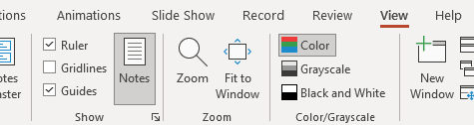


Working area, guides & ruler
Working area
Depending on the slide, a single-column layout, a 2-column or 3-column layout is used.
Display the ruler and guides in the «View» tab.

Slide 38
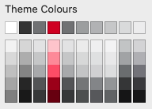
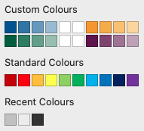
bbv colour theme
Always OK!
Never, please!
Default text colours
Main accent
Colours for diagrams, charts, graphs etc.
Use selectively and sparingly
Never, please!
Colours for diagrams, charts, graphs etc.
Colours for diagrams, charts, graphs etc.

